Slide 1
Study Unit 1 Introduction to Python Programming

Slide 2
Python Programming Environment

Slide 3
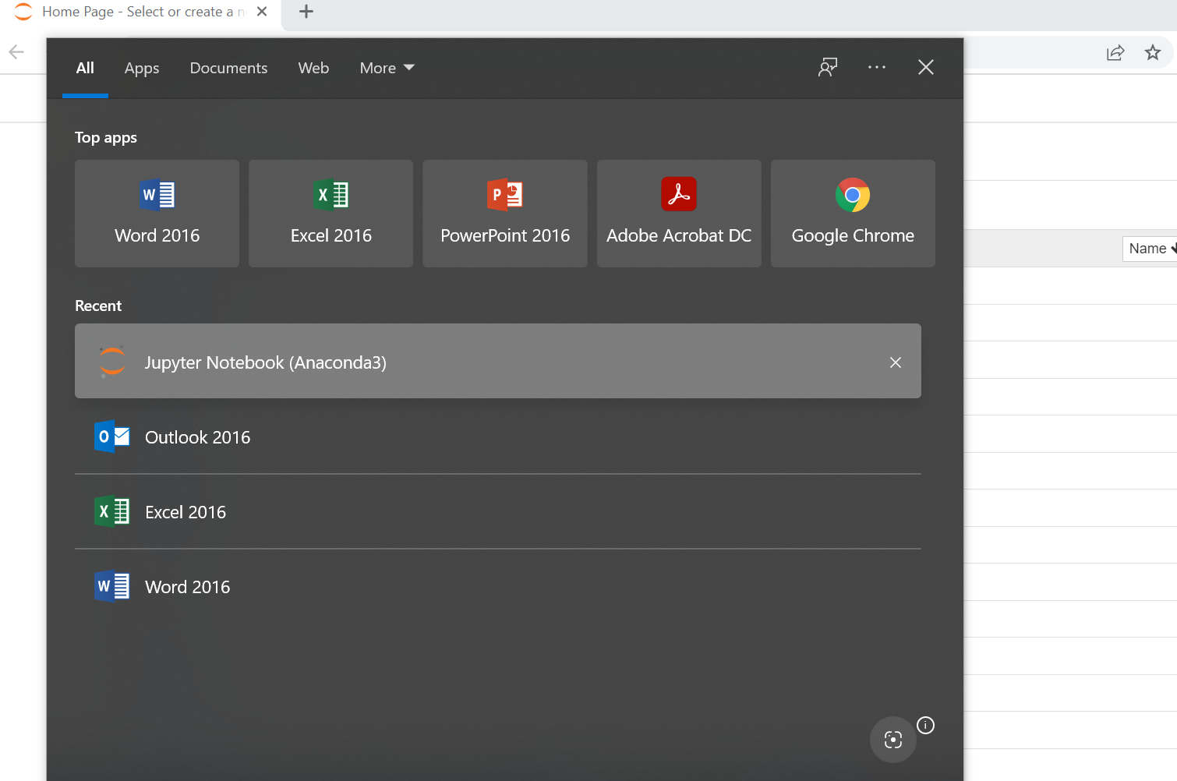
Installation of Python
Install Anaconda distribution at https://www.anaconda.com/
This installation comes with Jupyter Lab, Jupyter Notebook, Spyder, R Studio etc.)
Use default options for installation
After installation, choose Jupyter notebook (anaconda3) from Window Start

Slide 4
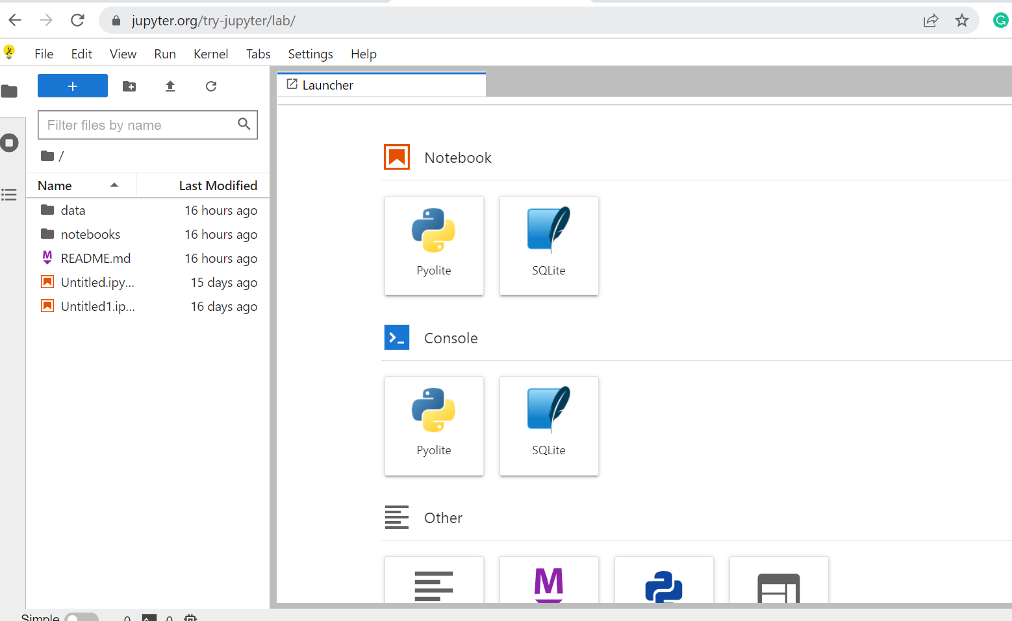
Installation of Python
Note: Students who encounter installation issues may start by using Jupyter Lab at: https://jupyter.org/try-jupyter/lab/

Slide 5
Introduction to JupyterLab

Slide 6
Introduction to JupyterLab
JupyterLab is a web application specialised in data analytics using Python.
JupyterLab can be used to create Python code for
cleaning and transforming data
running numerical simulation
performing statistical modelling
data visualisation
machine learning

Slide 7
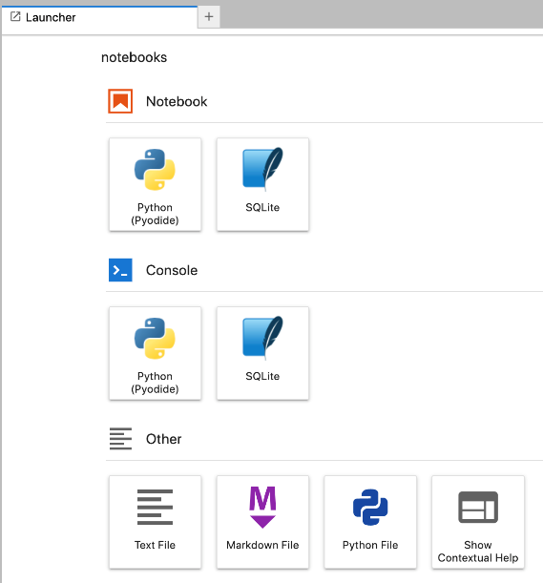
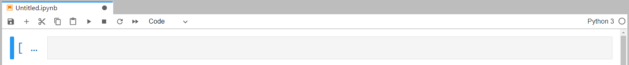
Start JupyterLab
JupyterLab can be launched by typing in the following URL in the address bar of your internet browser:
https://jupyter.org/try-jupyter/lab/

Slide 8
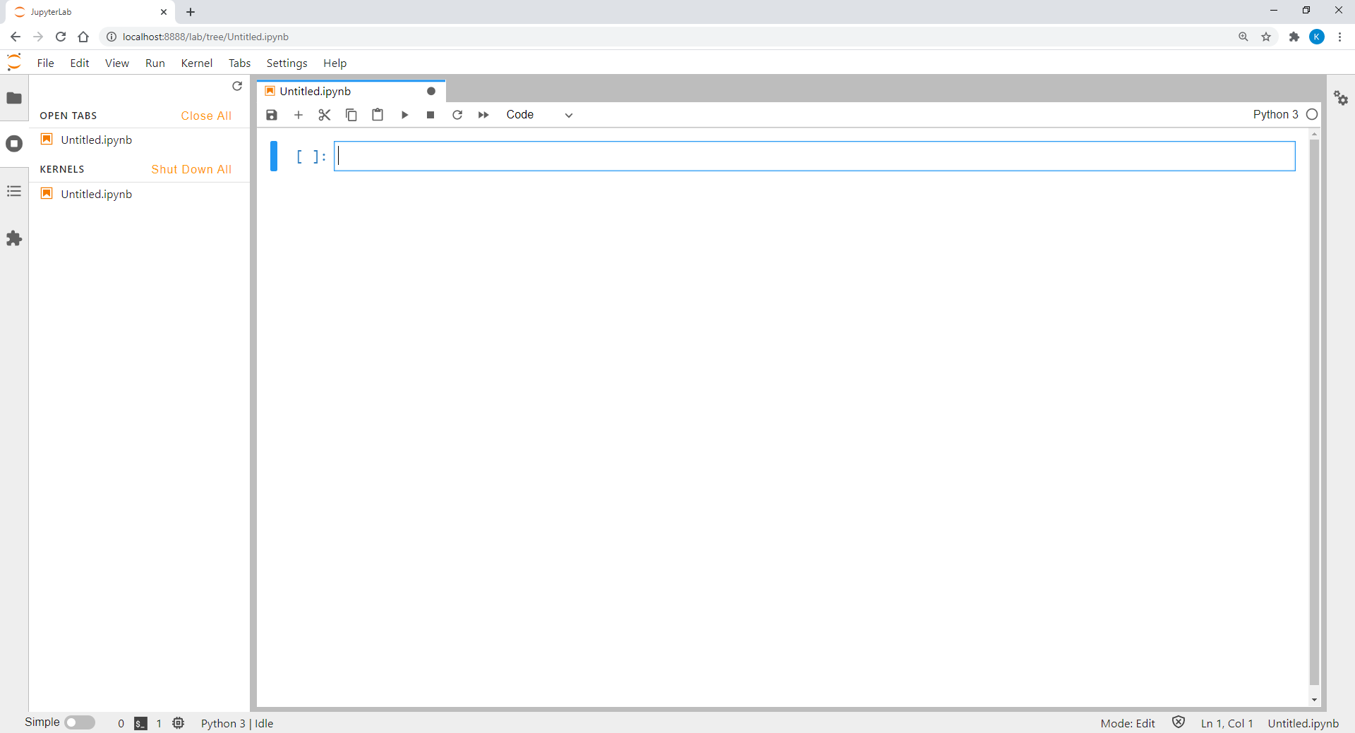
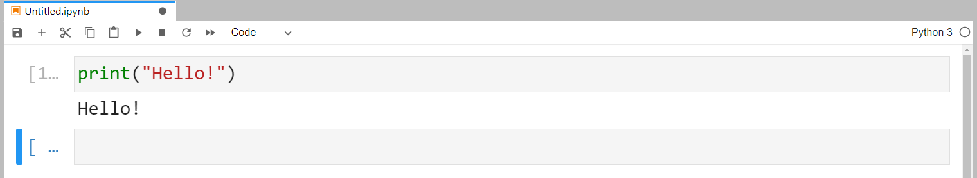
Programming with JupyterLab
Python program in JupyterLab cell can be executed by clicking or pressing CTRL + ENTER.
The output of the program script will then be printed below the input box.

Slide 9
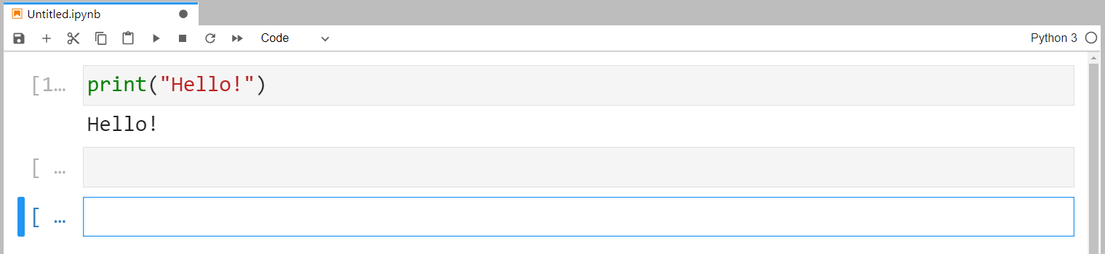
Writing and Running Codes in Cells
To add a new cell, press .
We can go back to previous cells any time and modify the code there.
Normally, JupyterLab only executes code of one cell.
We can run the code flexibly regardless the sequence of the cells.
To run all cells, go to “Kernel” and select “Restart Kernel & Run All Cells…”.
In this case, the order of the cells becomes essential.

Slide 10
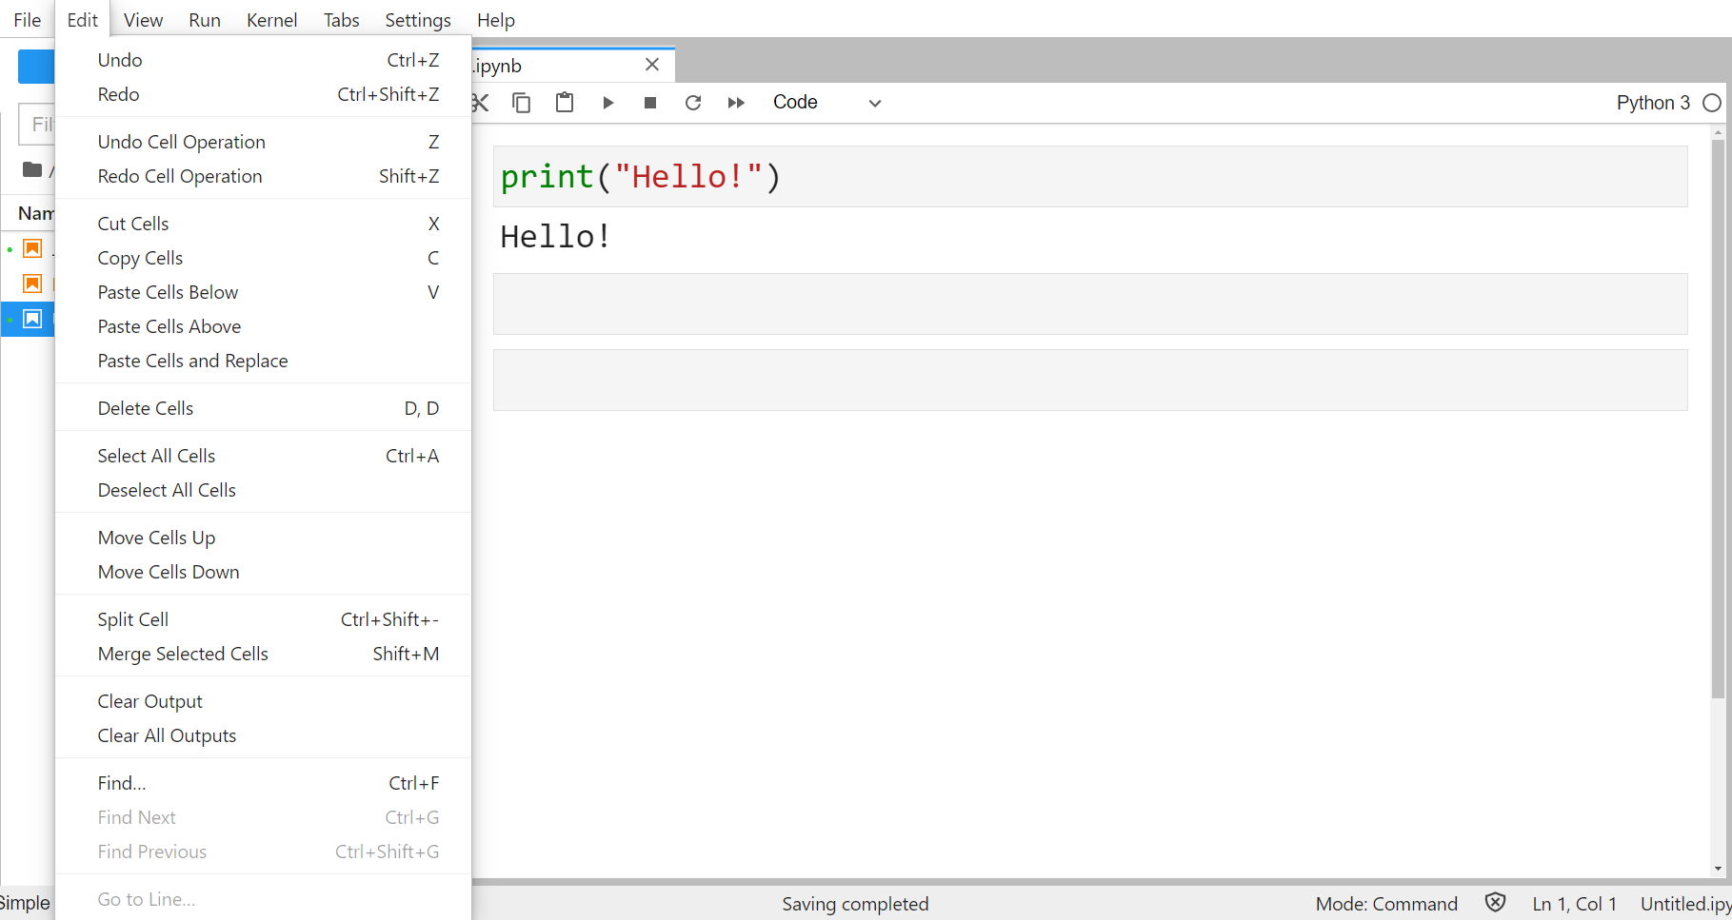
Edit JupyterLab Notebook
JupyterLab provides many functions to restructure our Python scripts.
Below is the “Edit” menu with all available options.

Slide 11
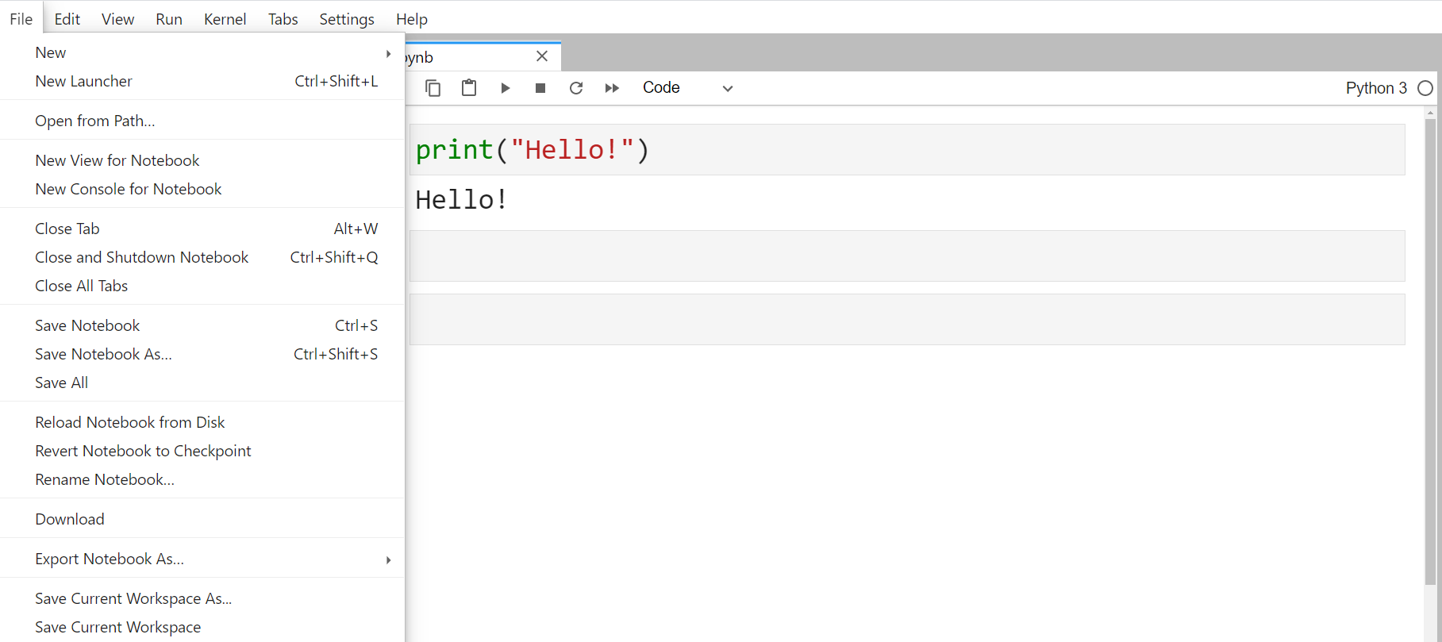
Save JupyterLab Notebook
Save JupyterLab notebook by pressing or “Save Notebook as…” in the “File” menu.
Notebook is saved as a “.ipynb” file in the folder where JupyterLab was started.

Slide 12
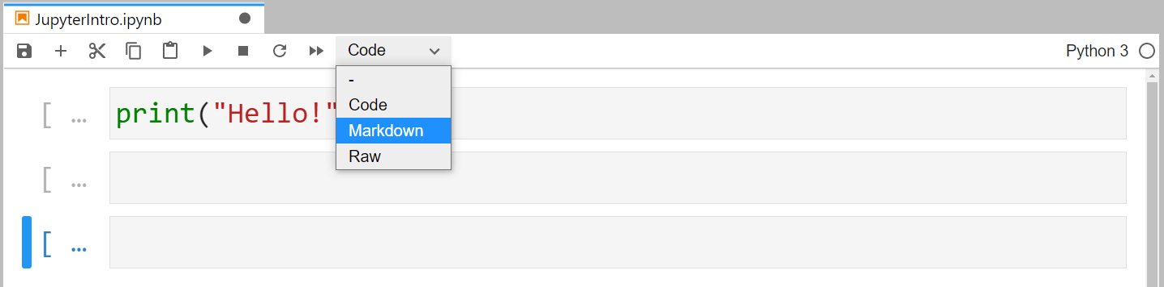
Markdown
JupyterLab can be used an advanced text editor.
Headers, elaborative texts, HTML codes, etc., all could be embedded in a JupyterLab notebook.
To create the corresponding format, switch the cell type from “Code” to “Markdown”.

Slide 13
Activity
Start JupyterLab, open a new notebook and carry out the following tasks:
Carry out simple calculations such as 2 * (3 – 1.5²).
Print the result of the calculation using formatted printing in another cell.
Insert a markdown cell before the cell of step 1 and describe the calculation to be carried out.
Re-run all cells.
Save the notebook on the computer.

Slide 14
Discussion
What are the advantages of using JupyterLab for data analytics tasks in comparison to Atom?
What is the optimal size of a chuck of code in a single cell?

Slide 15
Using Python
Screen display in the slides
Note that the look-and-feel of some program output displays shown on the slides are a bit different from what you see on Jupyter notebook or lab.
But the contents should be the same.
In the Study Guide, we further introduce the use of other optional programming environments, such as Atom.io. You do not need to try it if you are not interested.

Slide 16
Basic Arithmetic and Variables

Slide 17
Arithmetic Operators
Python can carry out very sophisticated tasks.
But we can also use it as a simple calculator.
Operator | Function
+ Addition | Adds values on either side of the operator.
- Subtraction | Subtracts right hand operand from left hand operand.
* Multiplication | Multiplies values on either side of the operator.
/ Division | Divides left hand operand by right hand operand.
% Modulus | Returns remainder of a division.
** Exponent | Performs exponential (power) calculation on operators.
// Floor Division | Returns remainder after removing the decimal point.

Slide 18
Mathematical Calculations
Same as usual mathematics, calculation priority:
Parentheses > exponentiation > multiplication/division > addition/subtraction
Not included in basic Python: square root, logarithm, exponential, trigonometrical functions, etc.
Need import of the “math” library in the program.

Slide 19
Variables
Automate routine operations without program adjustment.
Flexibility for programmers and users.
Keep program general.

Slide 20
Variable Names
Variable names can be any arbitrary combination of
characters (A-Z, a-z),
underscores (_), and
numbers (0-9).
Variable names can be short as a single character or more descriptive.
Must start with a letter or the underscore character.
Cannot start with a number.
Case-sensitivity (age, Age and AGE are different!).

Slide 21
Assign Values to Variables
Value is changeable at any stage of the program.
Assign value by the syntax
Important: Place variable left of the equal sign and the value right of it!
variable = value

Slide 22
Variable Types (I)
Type | Description
Integer | Values without decimal point. Can be positive or negative.
Float | Arbitrary numeric value with a floating point.
String | Contains letters in both cases, special characters, and numbers. No mathematical operations can be applied on numbers assigned as string to a variable. Values must be written in a pair of quotation marks (single or double). Two strings can be concatenated by being “added up”.
Boolean (Bool) | True or False.

Slide 23
Variable Types (II)
Use type() function to check the type of the variable.
Python returns following values: int (for integer), float (for float), or str (for character string).
Expression is the general term for variables or when they are linked with operators, e.g., a + b.

Slide 24
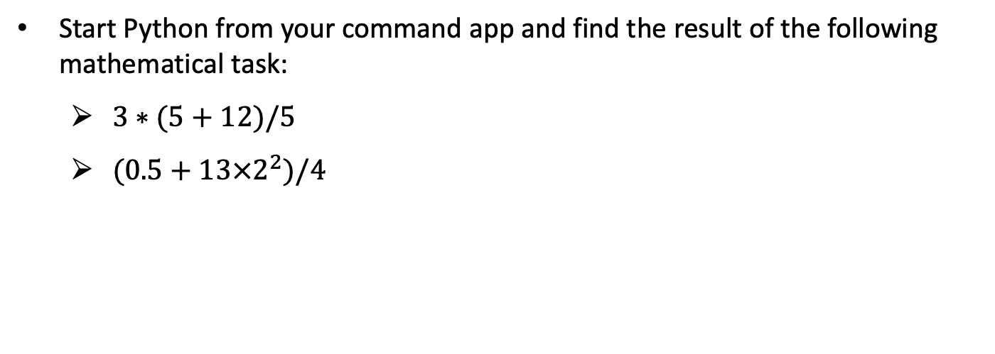
Activity
Start Python from your command app and find the result of the following mathematical task:
$3∗(5+12)/5$
$(0.5+13×2^{2})/4$

Slide 25
Discussion
How do we carry out mathematical calculations in Python? How similar is it in comparison to formulas written on paper?
What are the rules that a Python variable name must follow?
What is the difference between an integer and a float variable?

Slide 26
Print and Input

Slide 27
Printing
One main task of a computer program is to show information to the user while it is running.
Use print() function to generate screen output.
For both pre-defined strings or expression values.
When printing strings, put the content within the quotation marks.
print("My String")
print(expression)

Slide 28
Formatted Printing
Formatted printing combines pre-defined strings with values of expressions for screen output.
The combination of pre-defined strings with values of expressions is also called formatted string.
Add an “f” before the open quotation mark of the printing string.
Wrap the expressions within a pair of curly brackets {}.
Another option for formatted printing is the .format() method.
print(f"My String {expression1} {expression2} …")
print("My String {} {}".format(expression1, expression2))

Slide 29
Escape Sequences (I)
Use escape sequences to print special characters that
are invisible such as ENTER or linebreak (\n).
cause syntax error such as single (') or double quotation marks within a string which is wrapped within the same type of quotation marks.
Suppose a string is put in a double quotation mark, to avoid the error:
Use single quotation marks within the string.
Use escape sequences \" within the string instead of switching between single and double quotation marks.

Slide 30
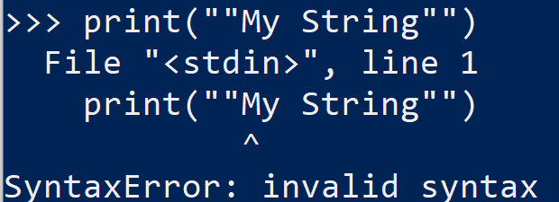
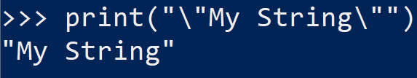
Example of escape sequences
Double quotations causes errors without using escape sequences
Double quotations does not cause errors with escape sequences

Slide 31
Escape Sequences (II)
Escape Sequences | Description
\newline | Backslash and newline ignored
\\ | Backslash (\)
\' | Single quote (')
\" | Double quote (")
\n | ENTER or line break
\b | Backspace (BS)
\t | Horizontal Tab (TAB)
\v | Vertical Tab (VT)

Slide 32
Input
Assign values to variables using user input during run time.
It requires users to type in something and then press ENTER.
It is allowed to use formatted strings in input().
Values assigned by an input() function are stored as string.
Convert string variables to become integer or float:
Both int() or float() only work if the input is a number.
variable = input("My String")
variable = int(input("My String"))
variable = float(input("My String"))

Slide 33
If-elif-else-Conditions

Slide 34
Boolean Expressions
Boolean expression has two outcomes: True or False.
Result of a single or multiple relational operations.
Multiple relational operations are combined by logical operators.
Examples of Relational Operation:
Relational Operation | Result
1 == 1 | True
3 > 2 | True
0 <= -5 | False
a + b < 10 | False if a + b >= 10

Slide 35
Relational Operators
To check equality of two expressions, use double equal sign (==).
Single equal sign (=) is used for assigning value to a variable.
List of Relational Operators in Python:
Operator | Description
== | True if the values of two operands are equal.
!= or <> | True if values of two operands are not equal.
> | True if left operand is greater than right operand.
< | True if left operand is less than right operand.
>= | True if left operand is greater than or equal to right operand.
<= | True if left operand is less than or equal to right operand.

Slide 36
Logical Operators
Multiple relational operations are connected by the logical operators.
Below is a list of logical operators in Python:
Operator | Description
and | If both the operands are true, condition becomes true.
or | If any of the two operands are True, condition becomes true.
not | Used to reverse the logical state of its operand.

Slide 37
if-block
Boolean expressions are embedded in if-conditional statement.
The result of the expression changes the program’s behaviour dynamically.
If condition is True, instructions will be executed.
If condition is False, Python will skip executing the if-block.
It is mandatory to put a colon directly behind the condition.
Instructions must be indented as part of the if-block.
if condition:
instructions

Slide 38
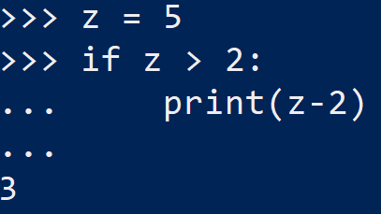
Example of an if condition
Create a variable, z = 5
If z > 2, we want python to print the value of z - 2

Slide 39
if-else-block
Execute another set of instructions if condition is False.
It is also mandatory to put a colon directly behind the else-statement.
Instructions must also be indented as part of the else-block.
if condition:
instructions 1
else:
instructions 2

Slide 40
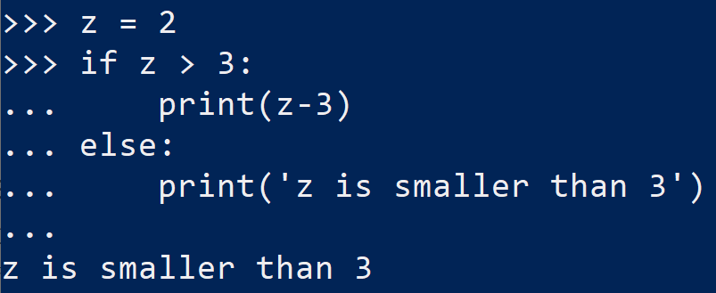
Example of if-else block
Now, we create a variable z = 2
If z > 3, we want python to print the value of z – 3
Else, we want python to print ‘z is smaller than 3’

Slide 41
if-elif-else-block
Execute multiple sets of instructions if-condition has multiple outcomes.
The else-statement is not compulsory here.
Ensure if-statement and elif-statements cover all possible outcomes.
Only omit those possibilities that do not need instructions to follow up.
if condition 1:
instructions 1
elif condition 2:
instructions 2
else:
instructions 3

Slide 42
Loops

Slide 43
while-Loops
Loops is used to repeat instructions that will be applied for many times.
The condition controls whether the loop will run a new iteration or not.
If it is True, Python will execute the instructions written with indentation.
Number of loops can be infinite.
The loop will be repeated as long as the condition is True.
Ensure there is an exit condition for the loop to terminate.
while condition:
instructions

Slide 44
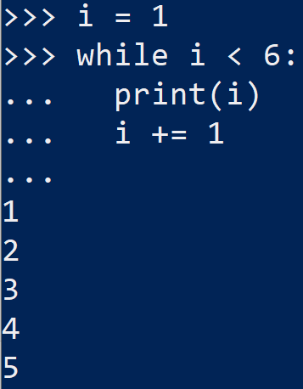
Example of while loop
Create a variable i = 1
while i < 6, print i
increase i by 1 for each iteration to prevent infinite loop
i.e., i += 1

Slide 45
Generate Integer list
A for-loop needs a list to iterate.
The number of loops is equivalent to the length of the list.
To generate a simple list of consecutive integers:
Basically, for-loop supports the iteration through any Python list.
variable = range(start, end)

Slide 46
for-Loops
Integrate the range() function in the for-statement:
The for-command ends with a colon.
Instructions executed in each iteration are written with indentation.
Counter variable counts the iteration of the loop.
Loop ends when counter reaches end – 1.
for counter in range(start, end):
instructions

Slide 47
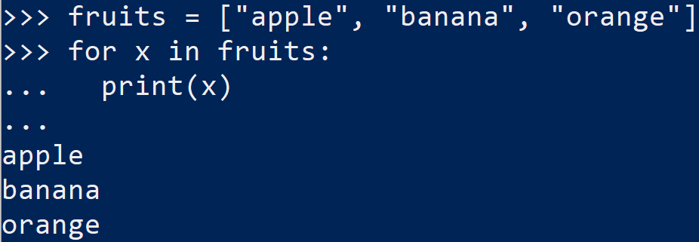
Example of for-loop
Create a list of fruits = [‘apple’, ‘orange’, ‘banana’]
For each element in fruits, print the element

Slide 48
Error Handling
Python stops executing program once error occurs.
To avoid Python from stopping the execution by force:
try:
instructions
except exception:
instructions
else:
instructions
finally:
instructions

Slide 49
Exceptions
List of some common built-in exceptions in Python:
Exception | Description
NameError | Raised when a local or global name is not found. This applies only to unqualified names. The associated value is an error message that includes the name that could not be found.
TypeError | Raised when an operation or function is applied to an object of inappropriate type. The associated value is a string giving details about the type mismatch.
ValueError | Raised when an operation or function receives an argument that has the right type but an inappropriate value, and the situation is not described by a more precise exception.

Slide 50
Error Handling in Input
Construct a while-loop around a try-block to handle errors.
The loop condition indicates the validity of an input.
If this Boolean variable is True (input is valid), the program will break from the loop.

Slide 51
Activity for Study Unit 1
Boston housing data:
Use Jupyter lab.
Go to the ANL252_HousingData_Demo notebook file and run through the cells that uses various commands to print the data and target values of the Housing data.
Finally, we will also plot a histogram of the housing prices
Discuss your observations from the program outputs

